Slide 1
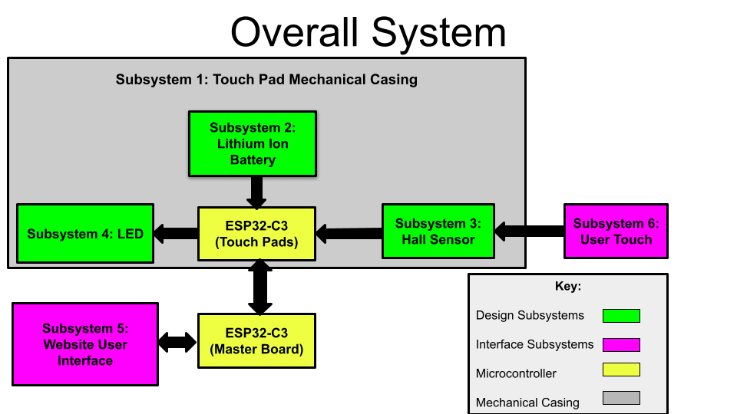
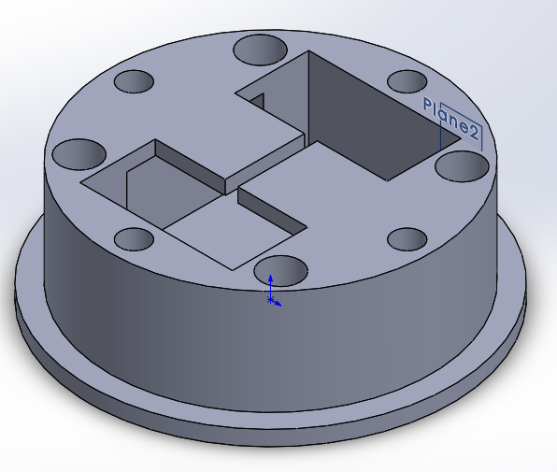
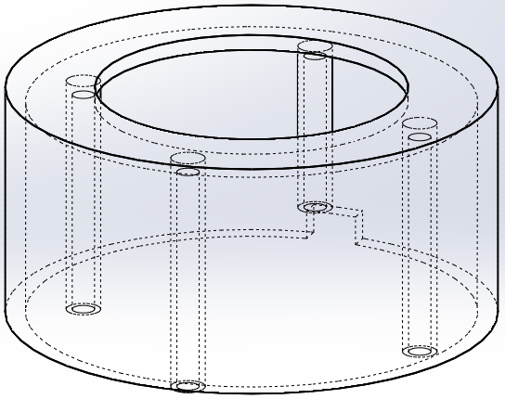
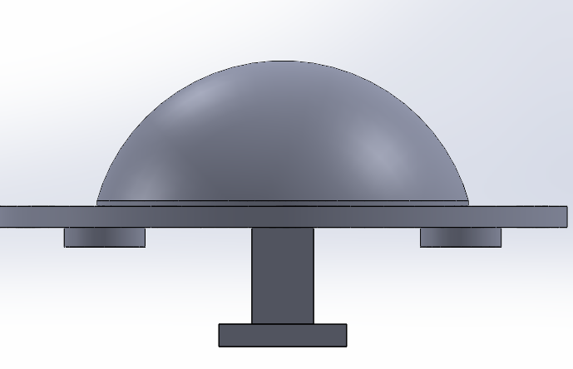
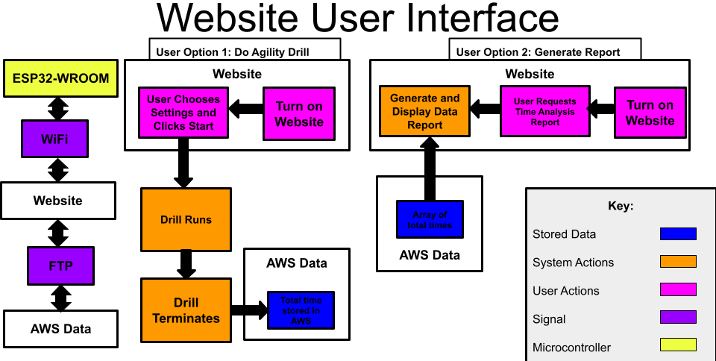
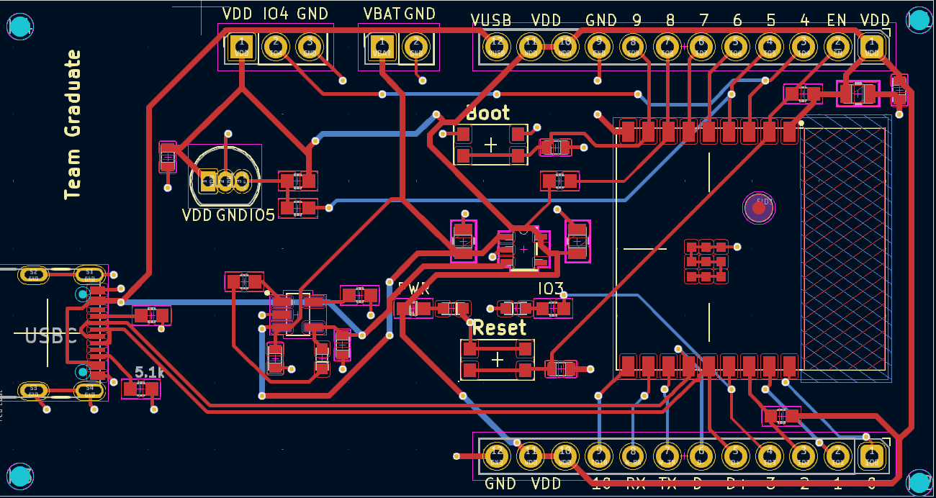
Athletic Trainer Pads
Kate Hjorth, Caroline Cho, Mike Guyette, Addison Azar, Adrienne Miller
University of Notre Dame, Department of Electrical Engineering
Project Overview
Hardware
Software
We created Athletic Trainer Pads that serve as a standard to test speed and reflex. The pads themself direct a speed-based agility drill that connects to a website interface that analyzes and stores the user’s data metrics over time. This allows us to move beyond traditional methods of measuring speed and improving agility. The goal is to improve the quality of standard agility drills for users while increasing the efficiency of analysis for testers.
The hardware solution consists of four 3D printed “buttons” each containing:
1. PCB board (with ESP32-C3)
2. Analog Linear Hall sensor
3. Adafruit LED Neopixel
In addition to a “master” board that interfaces with the software system
Mechanical Casing (“buttons”)
This mechanical casing was designed using the CAD software SolidWorks and then produced using 3D printing
Materials: clear resin for the dome casing and ABS-M30, a production-grade thermoplastic material, which offers high impact durability and water-resistance.
Magnet attached to appendage so that when button is pushed down, magnet is brought into proximity of the hall sensor. Spring to allow the button to be pushable
\\\\\\\
Hall Sensor and LED
Analog linear hall sensor: change in duty cycle if magnetic field is detected
LED: turns on/off based on hall sensor reading
PCB Board Design
- ESP32-C3-WROOM-02-H4
- Powered by 3.7 V rechargeable lithium ion battery
- When drill is commenced, ESP32 turns on LED and it stays on until a magnetic field is detected
The overall software system of our proposed solution consists of :
1. ESP-NOW communication between the boards
2. Website that the master board connects to via WiFi
3. AWS Bucket to store time data.
The drill is started and terminated in a master board which is not utilized as a button system. To start the drill, the master board uses its mac address to create a web server. The user can either initiate a drill or do data analysis. If the user chooses to initiate a drill, a random order of 10 buttons will be sent to the master board. The master board then communicates to the first slave board to light up via ESP-NOW communication. After the user hits the lit up touch pad, that button system will use ESP-NOW to communicate with the next button system to light up. Once all 10 buttons have been hit, the drill is completed and the total elapsed drill time is automatically stored in an AWS bucket. AWS buckets are cloud based storage that can be accessed via WiFi. If the user chooses to do data analysis, time data will be grabbed from the AWS bucket and put into a bar graph with individual bars representing total time for each execution of the drill.
System Requirements
1. Button systems provides visual cues to indicate when and where to strike
2. Button systems detects and withstands a force applied
3. System is wireless and rechargeable
4. Buttons communicate with one another via ESP-NOW
5. System can interface with a website via Wi-Fi
6. Accurate real-time data collection of overall reaction time
7. Website capable of time data storage with analysis of trends over time
Future Enhancements
1. Tailored workouts: difficulty level, specific pattern of touches, adaptive mode
2. Data collection & analysis for more specific and personalized reports: button position data, elapsed time between button presses, user physical characteristics
3. Software distinguishes between users and stores their data independently
4. Automatic power saver mode to foster greater battery life

